Slide 1


SMART INDIA HACKATHON 2025
CONVERGE (कन्व्हर्ज)
Problem Statement ID – SIH-136
Problem Statement Title – Converge: Public Innovation, Sandbox & Accelerated Procurement Architecture
Theme – Public Procurement & Smart Governance
PS Category – Software / Web Portal
Team ID – SIH:S:062
Team Name – PEGASUS

Slide 2
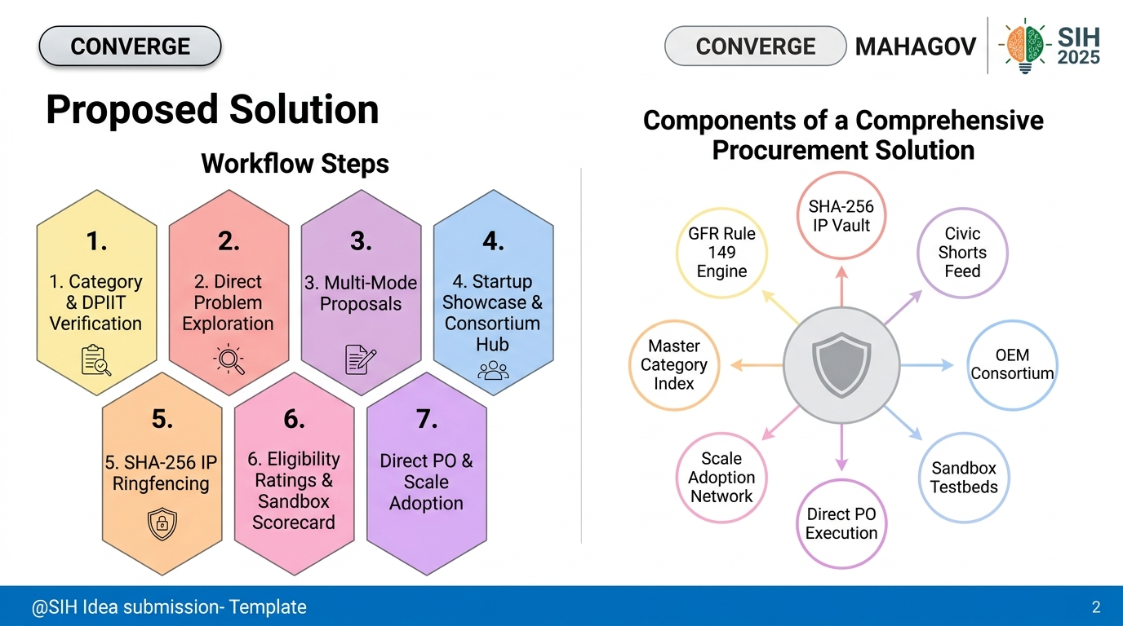
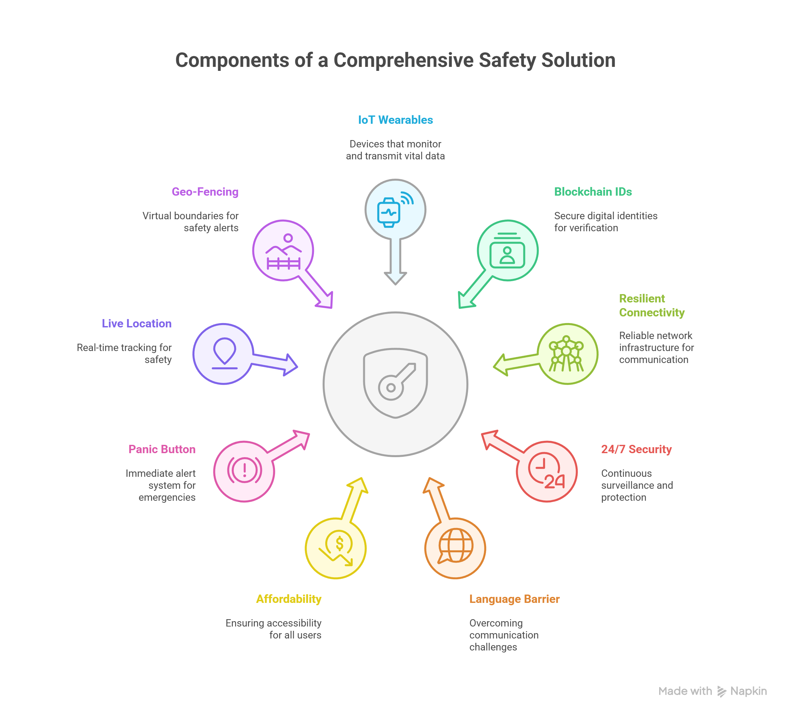
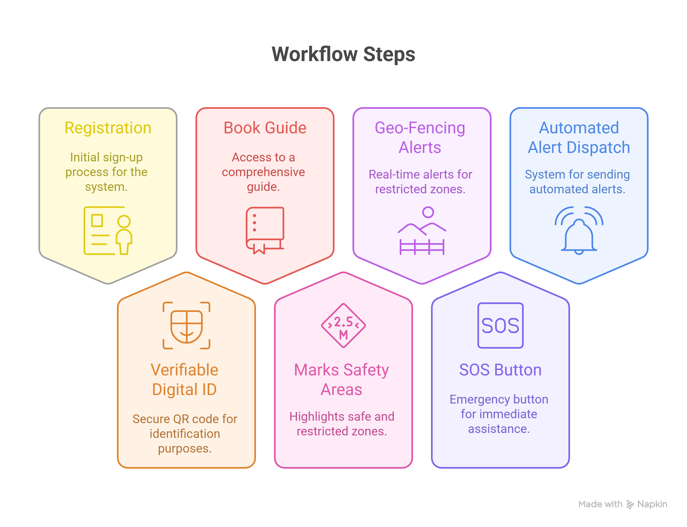
CONVERGE
PEGASUS
Proposed Solution

Slide 3




TECHNICAL APPROACH
PEGASUS
API / Technology Stack | Description & Implementation
React.js + TypeScript + Vite + TailwindCSS | Ultra-fast, responsive 3-column UI dashboard with dynamic category filters
Node.js + Express REST API + JSON Database | High-performance backend API serving problems, pilots, and persistent preferences
SHA-256 Cryptographic Hash Engine | Generates digital legal checksums ringfencing 100% of startup code & AI model IP
GFR Rule 149 Auto-Procurement Engine | Automates prior turnover & experience waivers for verified DPIIT startups
Sandbox Milestone Scorecard API | Calculates real-world trial scores against pre-published target benchmarks
Consortium Matchmaking Algorithm | Pairs agile AI startups with high-turnover OEM factories for joint bidding
Civic Shorts & Telemetry Feed | Citizen video challenge uploads, community upvoting & department endorsement
IndiaMART Master Category Index | 16+ sector taxonomy covering industrial equipment, medtech, agri-drones & IoT

Slide 4
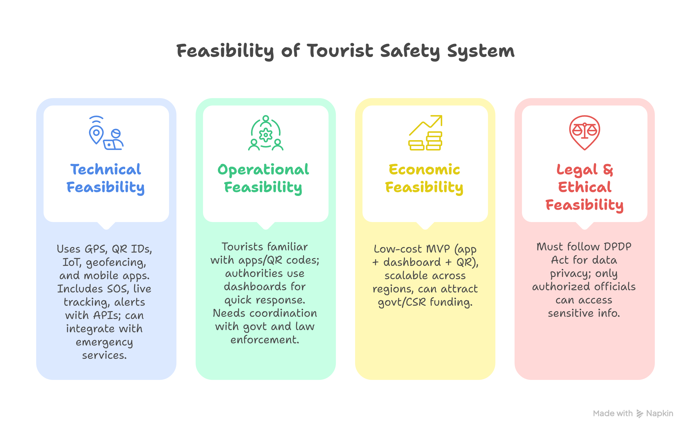
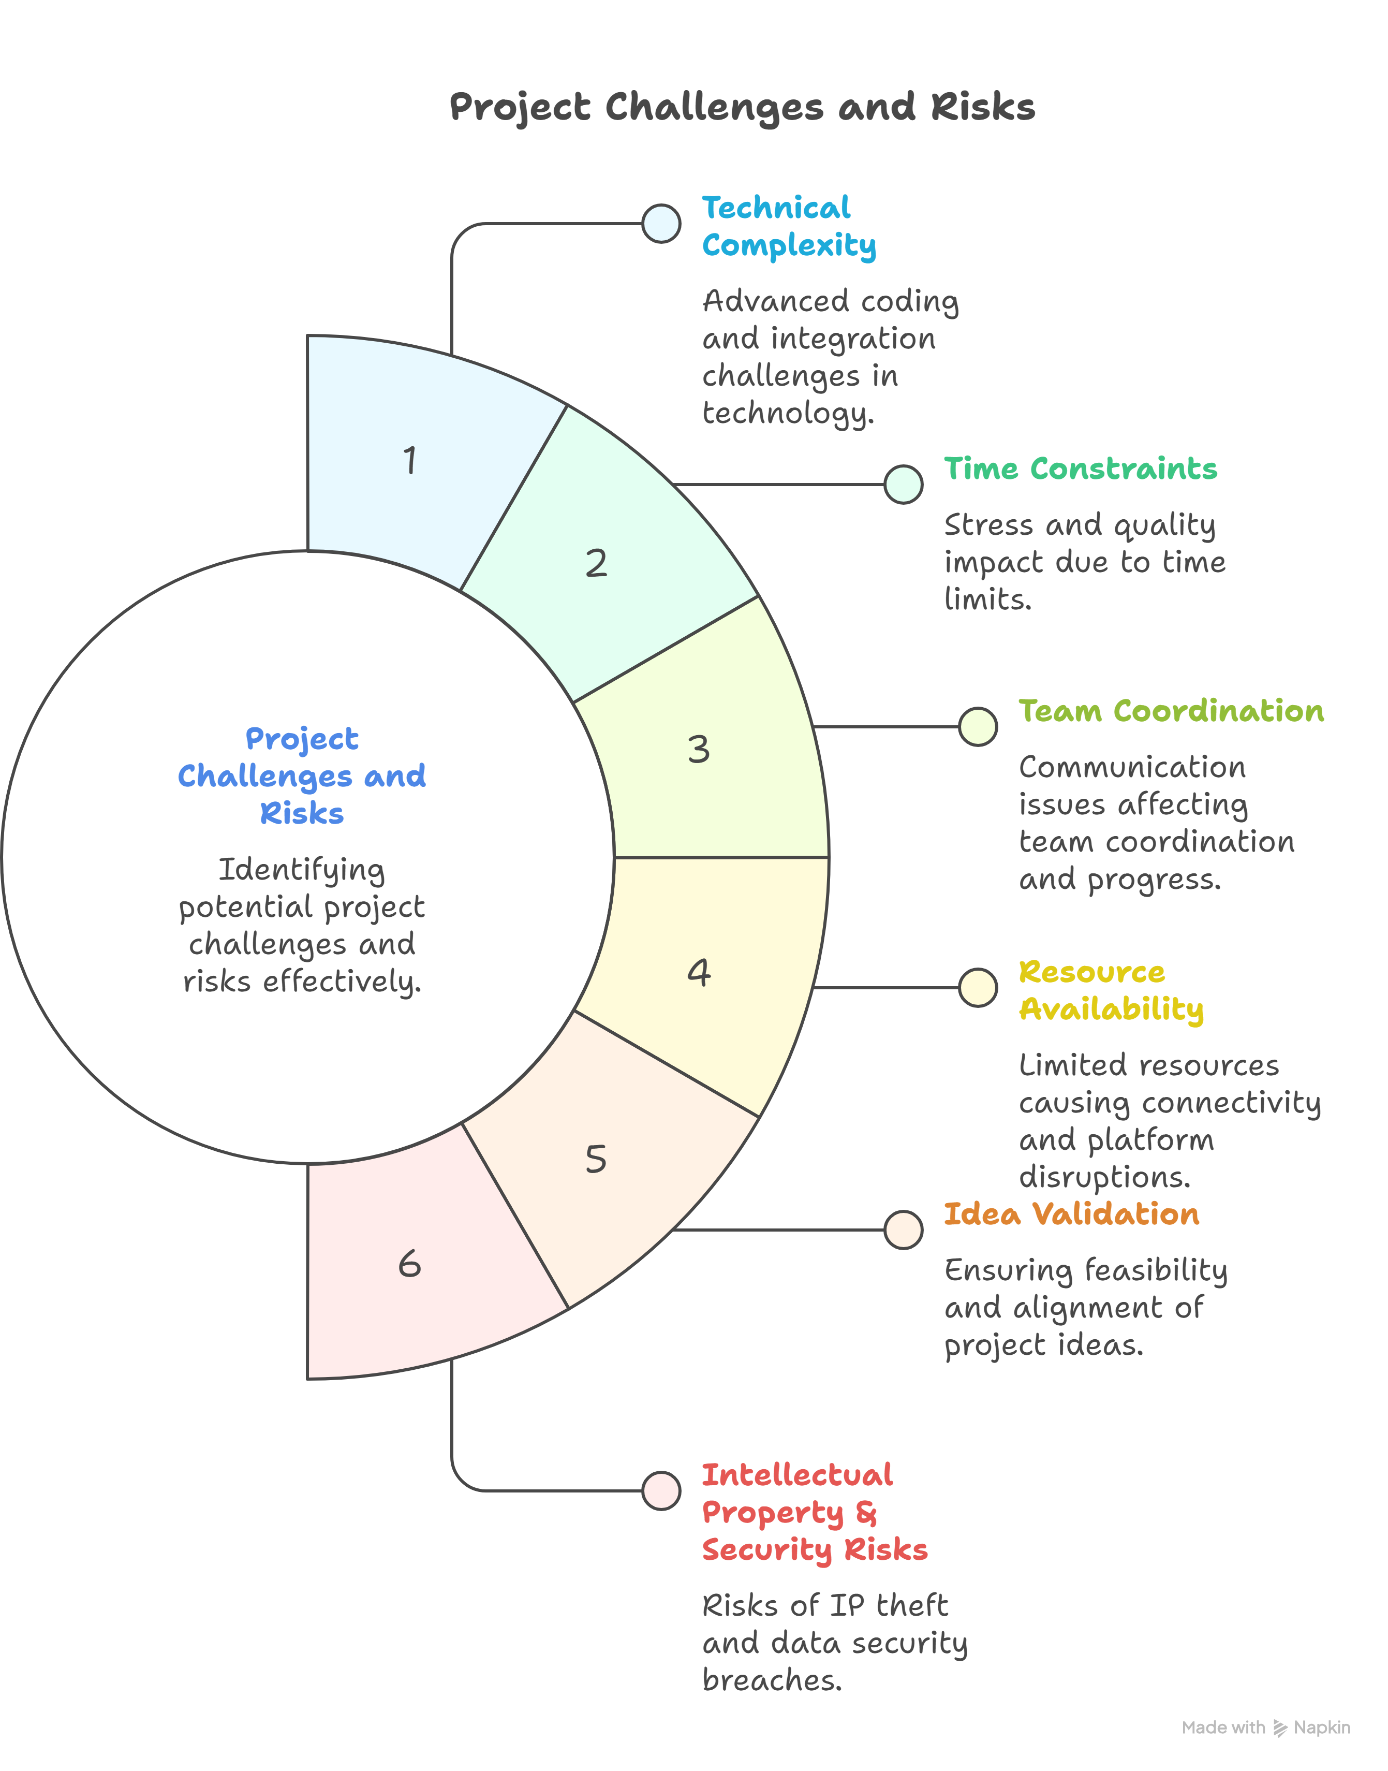
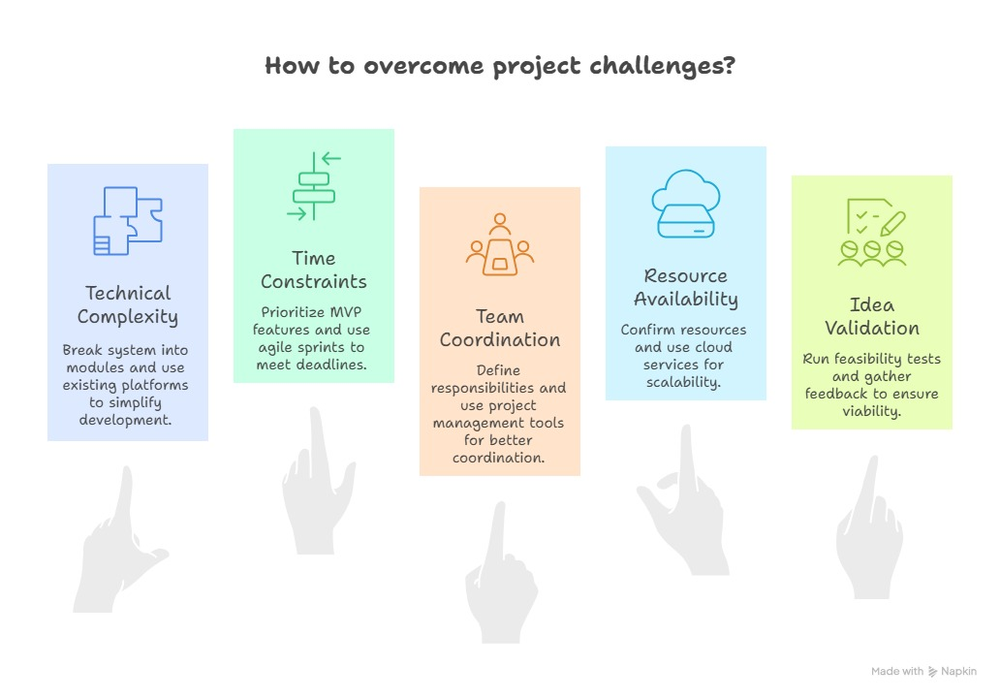
FEASIBILITY AND VIABILITY
PEGASUS
Technical Feasibility: Zero native C++ compilation dependencies; runs cleanly on Node.js & Vite with 100% TypeScript type safety.
Legal & GFR Compliance: Native integration of GFR-2017 Rule 149 waivers and Maharashtra State Startup Policy Sec 4.2.
Consortium Viability: Overcomes ₹50 Cr turnover barriers by pairing AI startups with registered OEM manufacturers.
Risk Mitigation: Pre-deployment Sandbox trials ensure public funds are only spent on verified, high-scoring solutions.
Scalability: 1-click cross-department scale adoption allows municipal bodies to replicate solutions without redundant re-bidding.

Slide 5
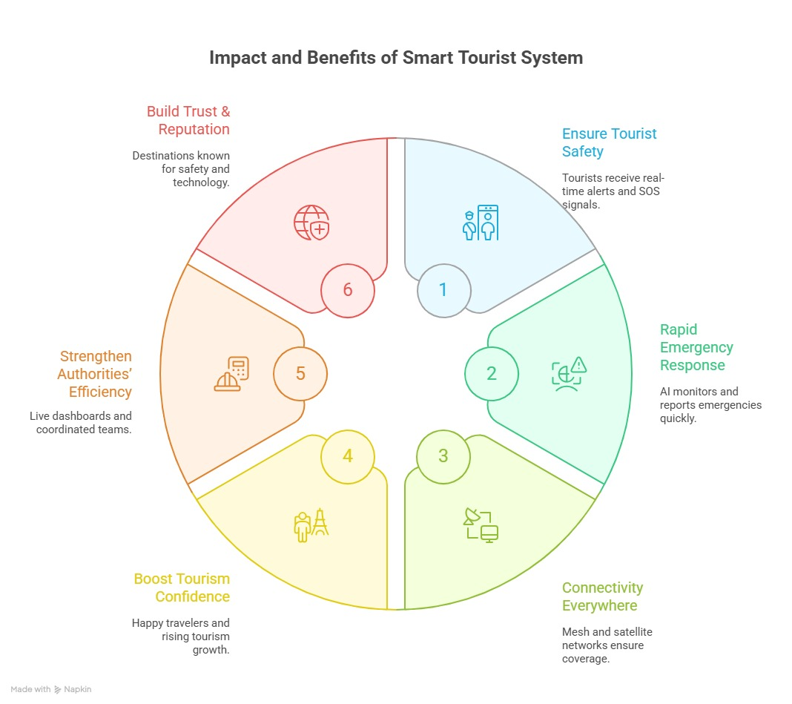
IMPACT AND BENEFITS
PEGASUS
• Impact on Startups: Eliminates 3-5 year turnover hurdles, provides SHA-256 IP protection, and opens direct government POs.
• Impact on Government Departments: Replaces 100-page PDF tender friction with structured metrics, video briefs, and sandbox proof.
• Impact on Citizens: Enables crowdsourcing of local civic challenges (potholes, crop diseases) with public upvoting and transparency.
• Economic Value: Saves up to ₹34 Crore annually in reactive road repairs and recovers 45M liters/day in non-revenue water loss.

Slide 6
RESEARCH AND REFERENCES
PEGASUS
General Financial Rules (GFR 2017) Rule 149 & 173 guidelines on public procurement & startup waivers.
Maharashtra State Startup Policy 2018 Sec 4.2 — relaxed procurement and turnover exemptions.
DPIIT (Department for Promotion of Industry and Internal Trade) Startup India procurement directives.
Government e-Marketplace (GeM) Startup Runway & L1 price comparison order frameworks.
Case Studies & Benchmarks:
- iDEX (Innovations for Defence Excellence) challenge-to-procurement framework.
- Maharashtra Startup Week pilot sandbox execution model.
- Smart India Hackathon SIH-136 Public Procurement & Sandbox Portal.

Slide 7
IMPORTANT INSTRUCTIONS
Please ensure below pointers are met while submitting the Idea PPT:
Kindly keep the maximum slides limit up to six (6). ( Including the title slide)
Try to avoid paragraphs and post your idea in points /diagrams / Infographics /pictures
Keep your explanation precise and easy to understand
Idea should be unique and novel.
You can only use provided template for making the PPT without changing the idea details pointers (mentioned in previous slides).
You need to save the file in PDF and upload the same on portal. No PPT, Word Doc or any other format will be supported.
Note - You can delete this slide (Important Pointers) when you upload the details of your idea on SIH portal.

